Slide 1
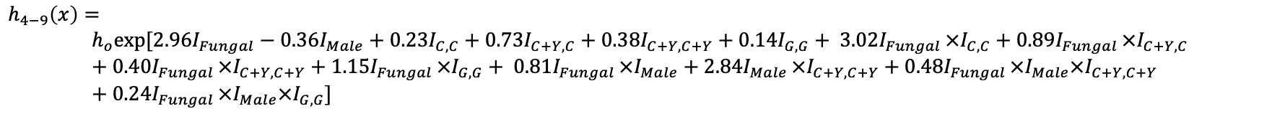
$$coxph\left(time, event\right)=Fungal+Male+Diet+Fungal×Diet+Fungal×Male+ Male×Diet_{C+Y,C+Y}$$
$$+Fungal×Male×Diet_{C+Y,C+Y}+Fungal×Male×Diet_{G,G}$$
$$h_{0−4}(x)=$$
$$h_{o}exp⁡[0.35I_{Fungal}+0.03I_{Male}−0.45I_{C,C}+0.31I_{C+Y,C}−0.11I_{C+Y,C+Y}+0.41I_{G,G}+ 3.02I_{Fungal }×I_{C,C}+0.89I_{Fungal }×I_{C+Y,C}+0.40I_{Fungal }×I_{C+Y,C+Y}+1.15I_{Fungal }×I_{G,G}+ 0.81I_{Fungal }×I_{Male}+3.03I_{Male }×I_{C+Y,C+Y} +{ 1.02I}_{Fungal }×I_{Male}×I_{C+Y,C+Y}+{0.24I}_{Fungal }×I_{Male}×I_{G,G}]$$
$$h_{4−9}\left(x\right)=$$
$$h_{o}exp⁡[2.96I_{Fungal}−0.36I_{Male}+0.23I_{C,C}+0.73I_{C+Y,C}+0.38I_{C+Y,C+Y}+0.14I_{G,G}+ 3.02I_{Fungal }×I_{C,C}+0.89I_{Fungal }×I_{C+Y,C}+0.40I_{Fungal }×I_{C+Y,C+Y}+1.15I_{Fungal }×I_{G,G}+ 0.81I_{Fungal }×I_{Male}+2.84I_{Male }×I_{C+Y,C+Y}+{ 0.48I}_{Fungal }×I_{Male}×I_{C+Y,C+Y}+0.24I_{Fungal }×I_{Male}×I_{G,G}]$$
$$h_{9−14}\left(x\right)=$$
$$h_{o}exp⁡[3.76I_{Fungal}+0.32I_{Male}−0.04I_{C,C}+0.63I_{C+Y,C}+0.66I_{C+Y,C+Y}−0.80I_{G,G}+ 3.02I_{Fungal }×I_{C,C}+0.89I_{Fungal }×I_{C+Y,C}+0.40I_{Fungal }×I_{C+Y,C+Y}+1.15I_{Fungal }×I_{G,G}+ 0.81I_{Fungal }×I_{Male}+0.83I_{Male }×I_{C+Y,C+Y}+{ 1.16I}_{Fungal }×I_{Male}×I_{C+Y,C+Y}+0.24I_{Fungal }×I_{Male}×I_{G,G}]$$

Slide 2
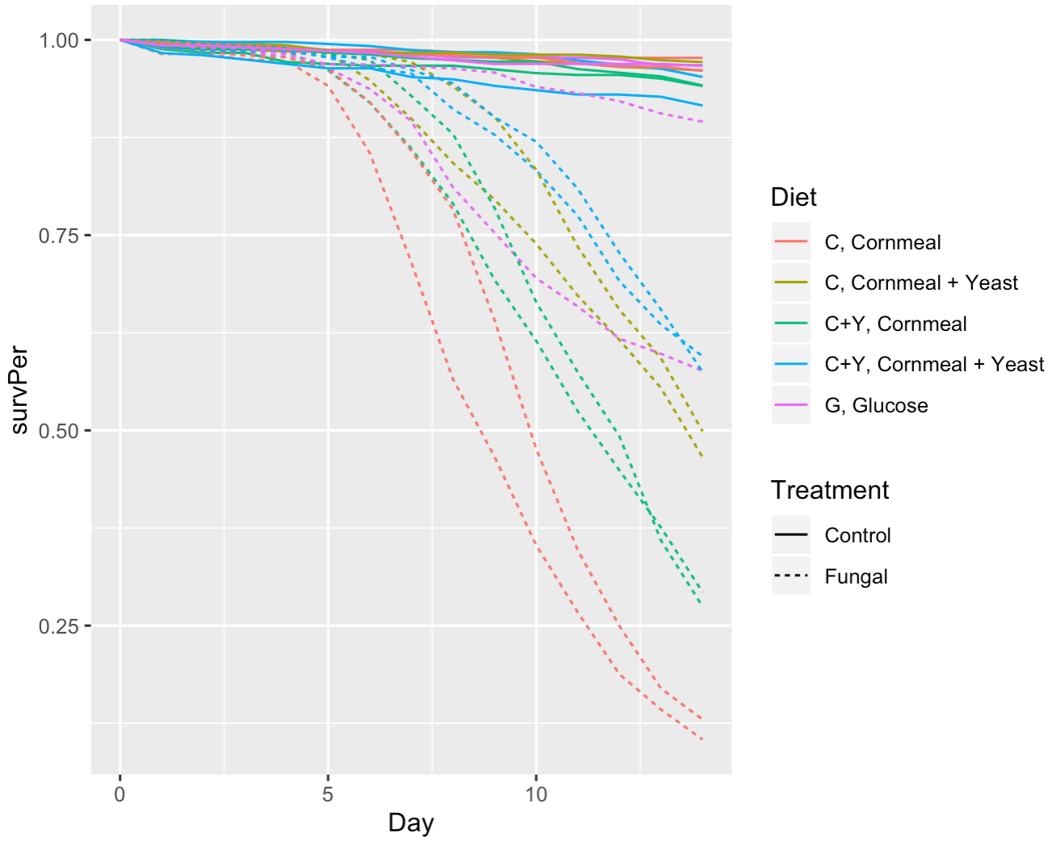
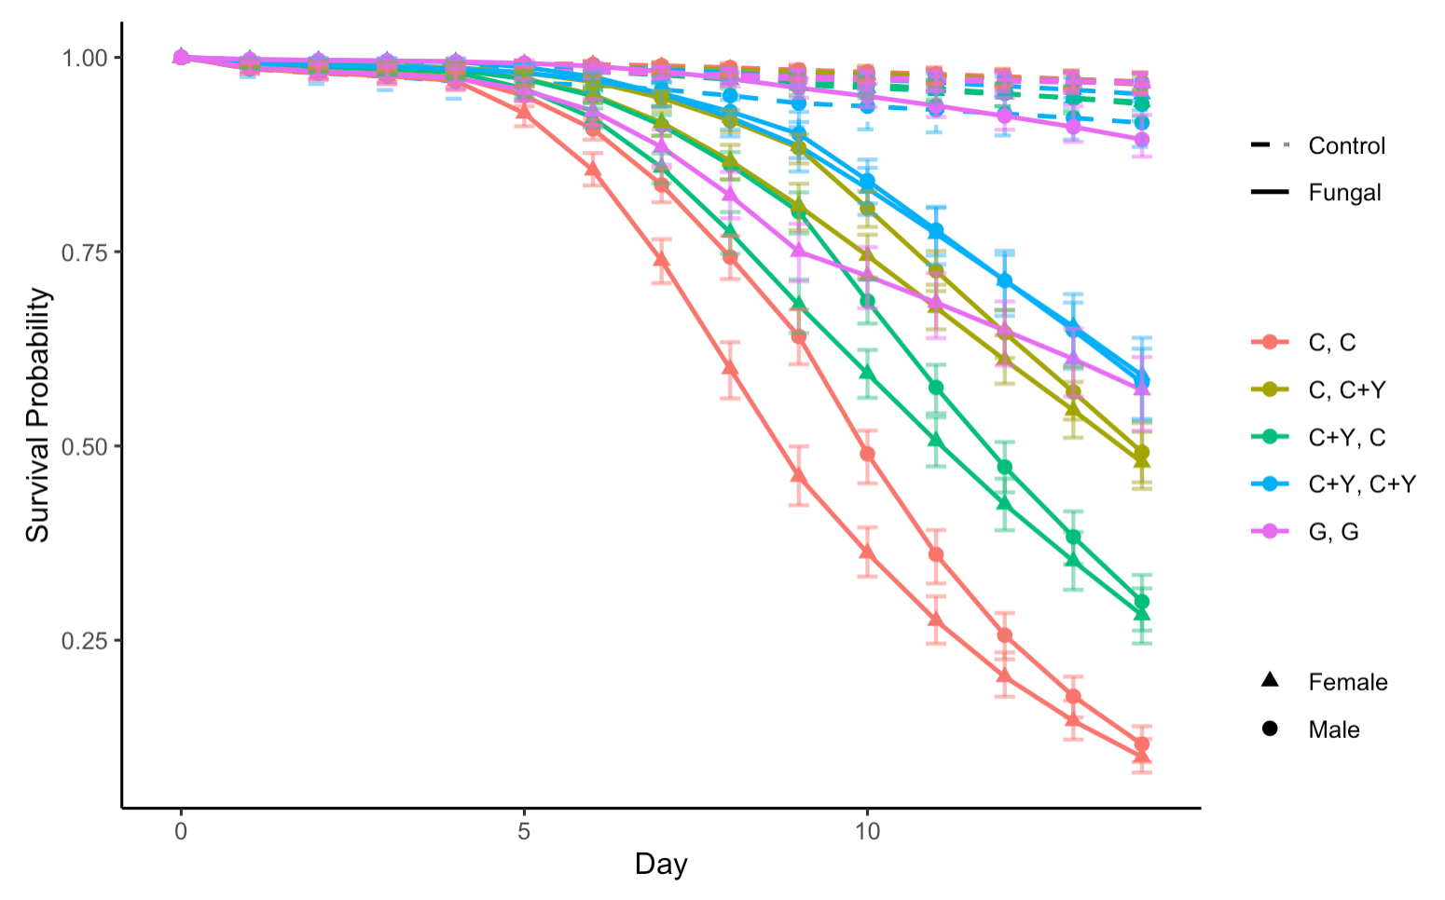
Figure 1: overall survival plot
Bootstrap: 200
Raw data plot
Model plot

Slide 3
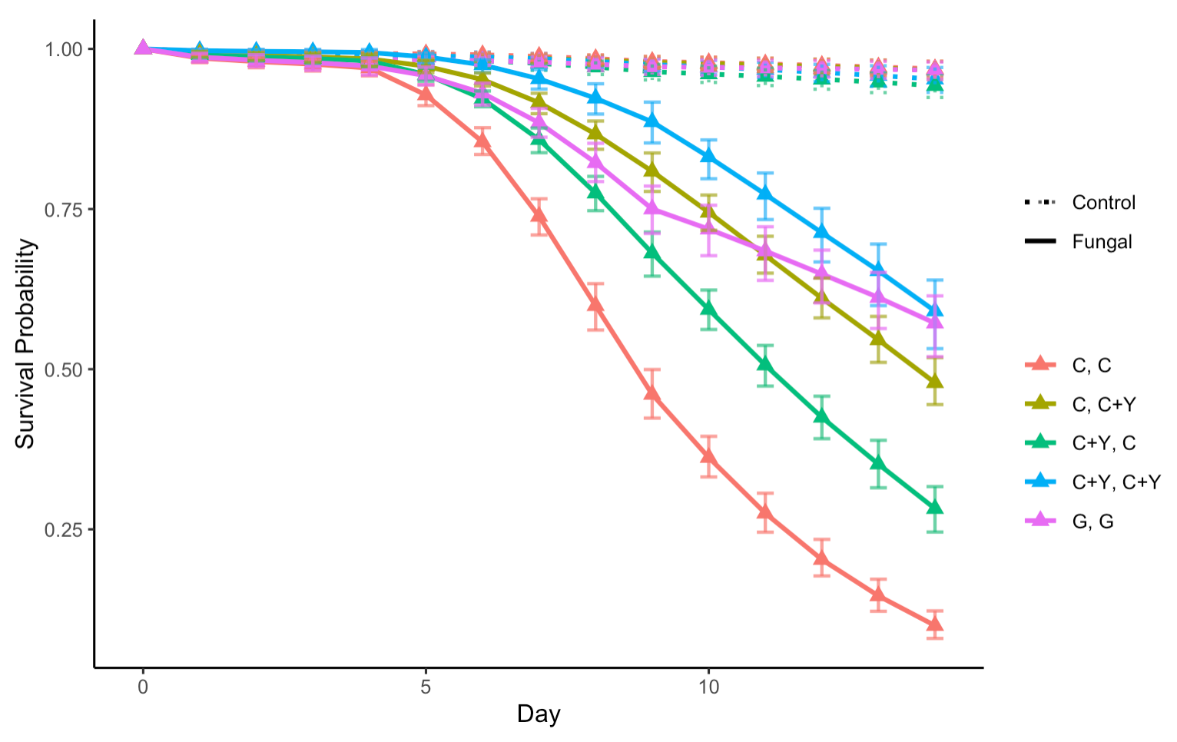
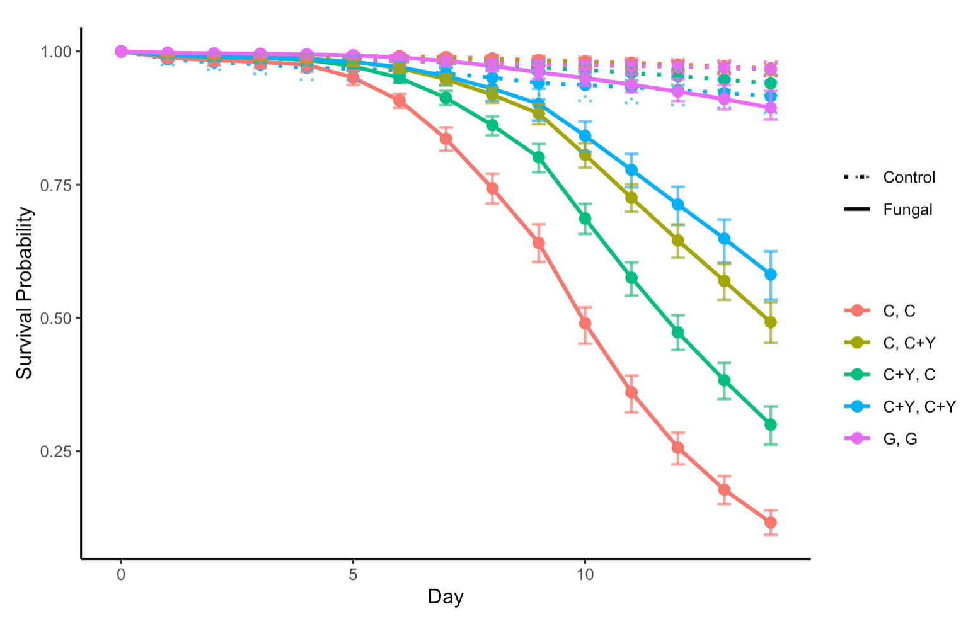
Figure 2: survival plots by Sex
Bootstrap: 200
Female
Male

Slide 4
Table 2: hazard ratios by Sex
Female
Male
Baseline: C, C + Y |  | 0 – 4 | 4 - 9 | 9 - 14
Hazard ratio (P-value) | C + Y, C + Y | 0.36 (0.0564) | 0.59 (0.0052) | 0.77 (0.0311)
 | C + Y, C | 1.22 (0.5342) | 1.86 (9.2327e-06) | 1.68 (2.3177e-07)
 | G, G | 1.732002 (0.1089984) | 1.326148 (0.04807224) | 0.52 (1.4070e-05)
 | C, C | 1.93 (0.0404) | 3.79 (2.1450e-13) | 2.92 (2.1760e-14)
Baseline: C, C + Y |  | 0 – 4 | 4 - 9 | 9 - 14
Hazard ratio (P-value) | C + Y, C + Y | 1.11 (0.8282) | 0.80 (0.2828) | 0.75 (0.0118)
 | C + Y, C | 1.22 (0.5342) | 1.86 (9.2327e-06) | 1.68 (2.3177e-07)
 | G, G | 0.41 (0.0196) | 0.31 (4.3652e-06) | 0.12 (7.6783e-13)
 | C, C | 1.93 (0.0404) | 3.79 (2.1450e-13) | 2.92 (2.1760e-14)

Slide 5
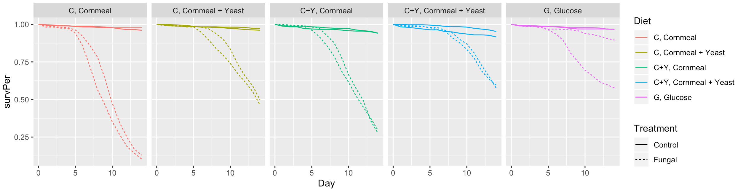
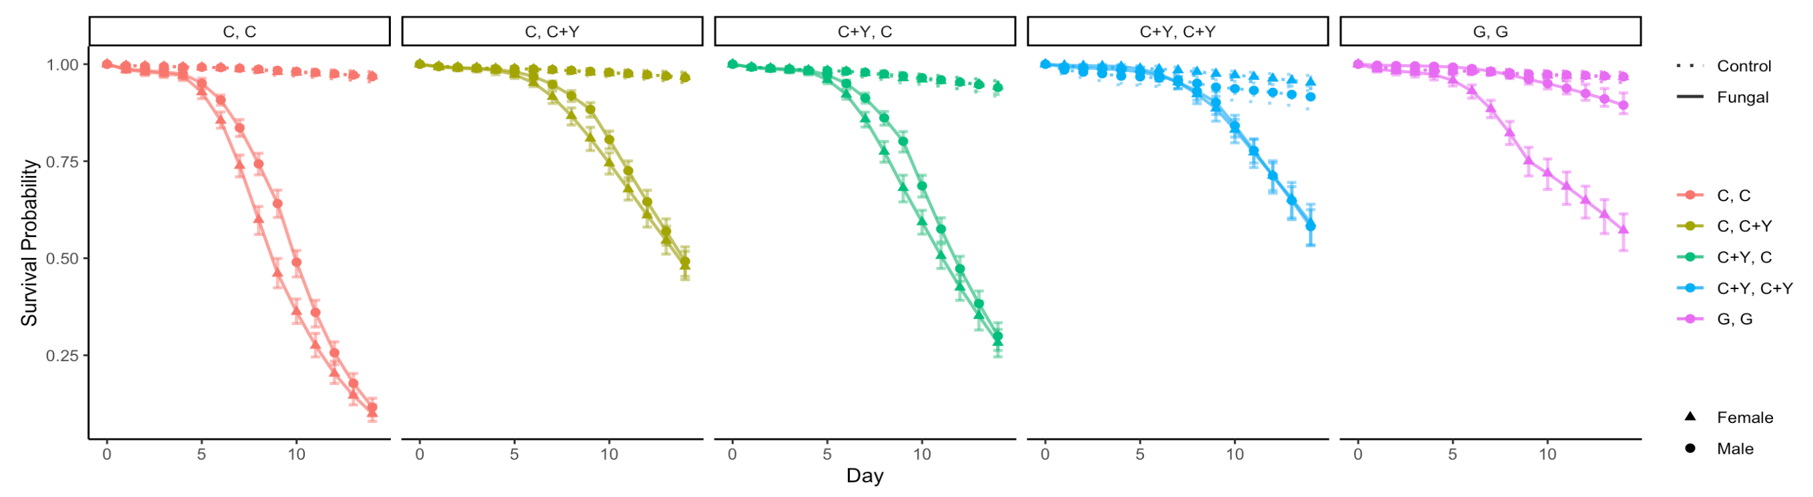
Figure 3: survival plots by Diet
Raw data plot
Model plot
Bootstrap: 200

Slide 6
Table 3: hazard ratios by Diet
Baseline: Male | 0-4 | 4-9 | 9-14
Control (p-value) | 0.97 (0.8863) | 1.44 (0.0783) | 0.72 (0.1079)
Fungal (p-value) | 1.20 (0.4208) | 1.77 (2.6149e-08) | 0.90 (0.0826)
Diet 1: C, C
Diet 2: C, C + Y
Diet 3: C + Y, C
Baseline: Male | 0-4 | 4-9 | 9-14
Control (p-value) | 0.32 (0.0368) | 0.51 (0.1274) | 0.87 (0.7435)
Fungal (p-value) | 0.39 (0.1325) | 1.29 (0.2599) | 0.93 (0.5406)
Diet 4: C + Y, C + Y
Diet 5: G, G
Baseline: Male | 0-4 | 4-9 | 9-14
Control (p-value) | 0.97 (0.8863) | 1.44 (0.0783) | 0.72 (0.1079)
Fungal (p-value) | 5.07 (1.6869e-06) | 7.52 (8.5190e-12) | 3.79 (3.6622e-08)

